Slide 1
The Pie and Daunaut
The Pie and Daunaut

Slide 2
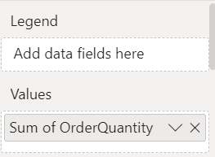
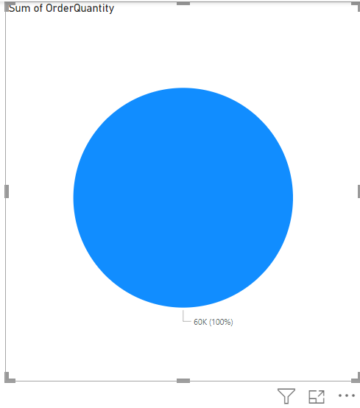
The Pie and Daunaut
Add Pie visualization to the scene then add OrderQuantity from FactInternetSales to the Values

Slide 3
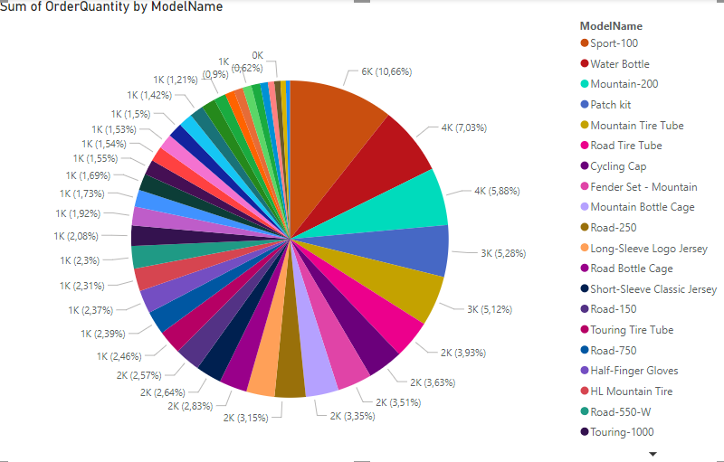
The Pie and Daunaut
Then add the ModelName from DimProduct at the Legend level

Slide 4
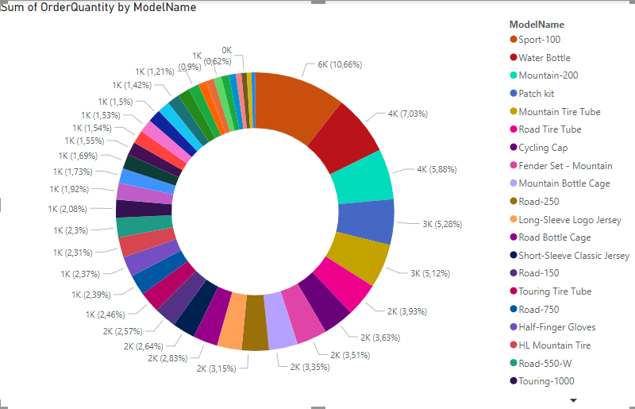
The Pie and Daunaut
Select Daunaut instead of Pie

Slide 5
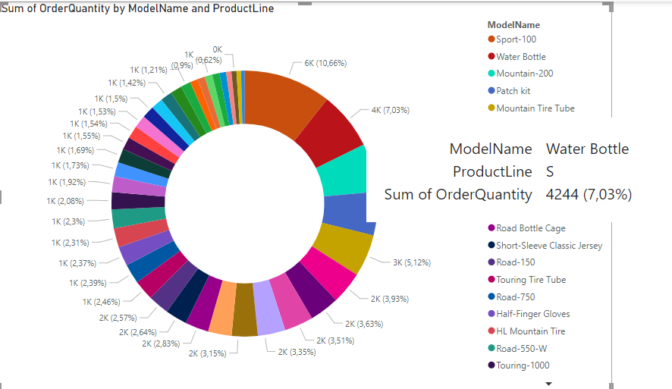
The Pie and Daunaut
Add ProductLine from DimProduct table to the Details field and hover the mouse on a given segment

Slide 6
Thank you
Thank you

